Slide 1
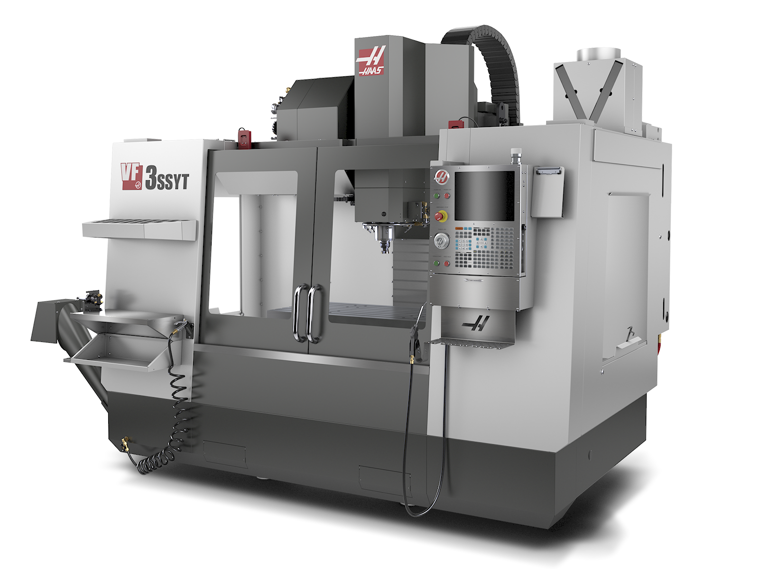
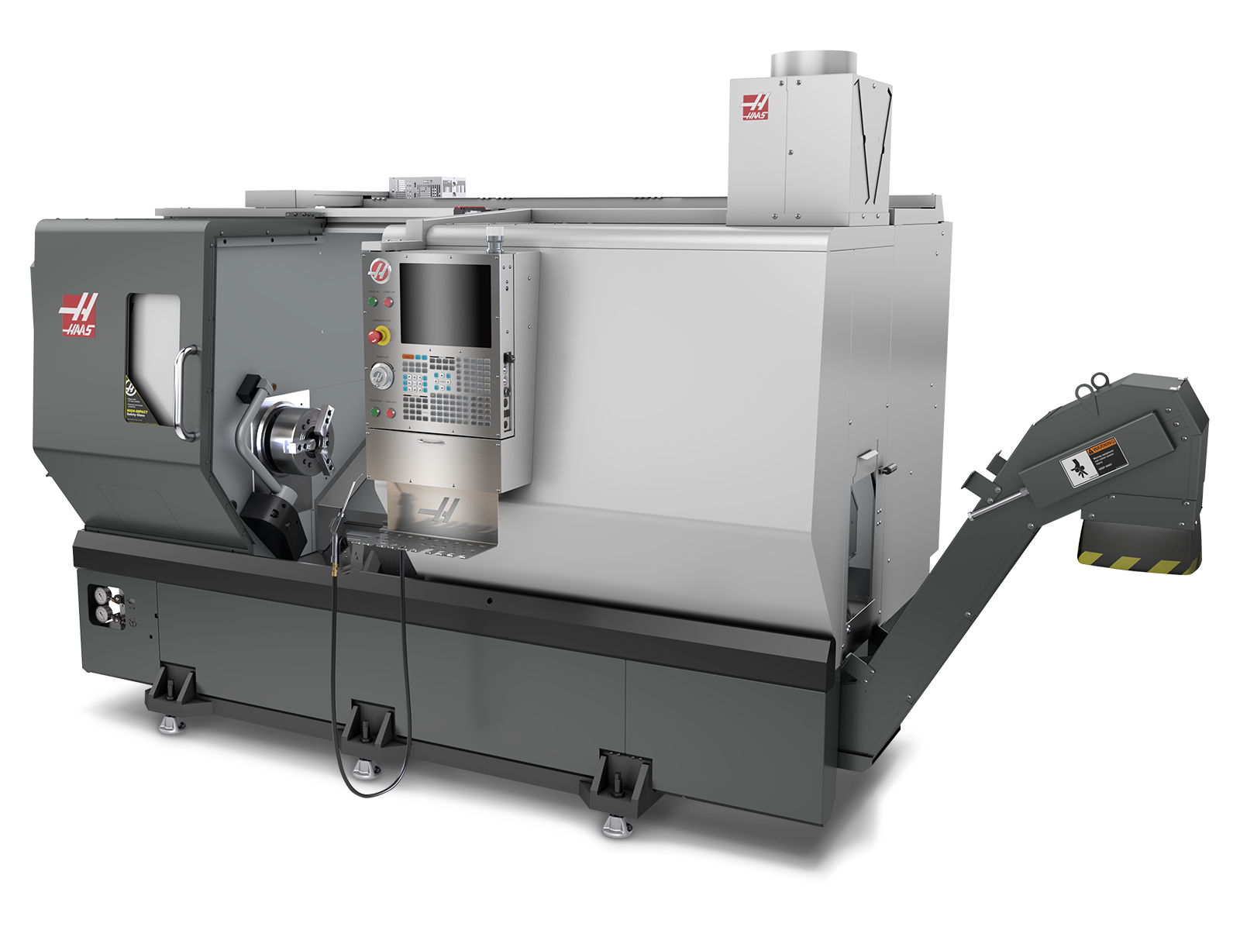
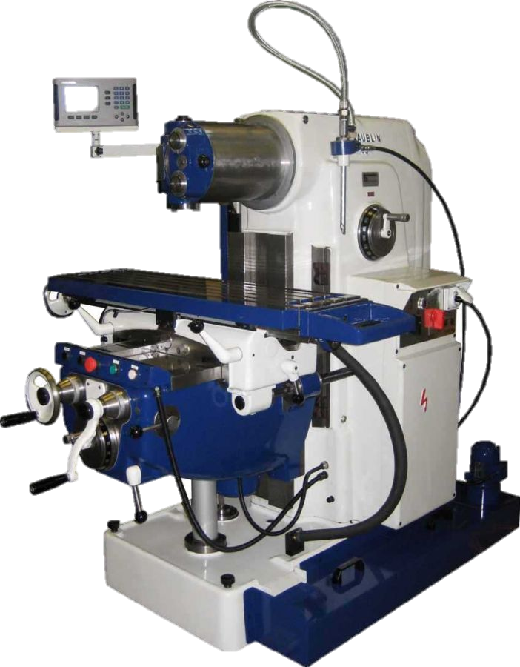
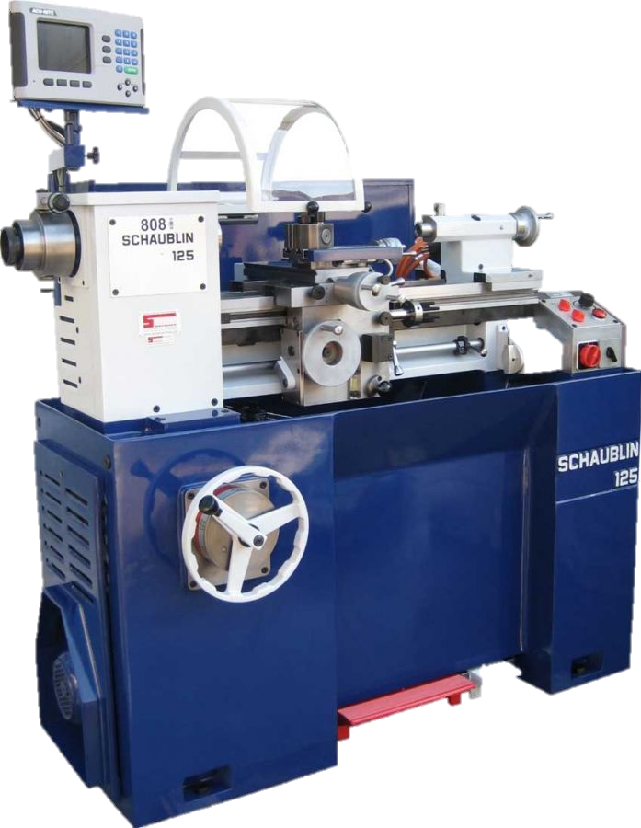
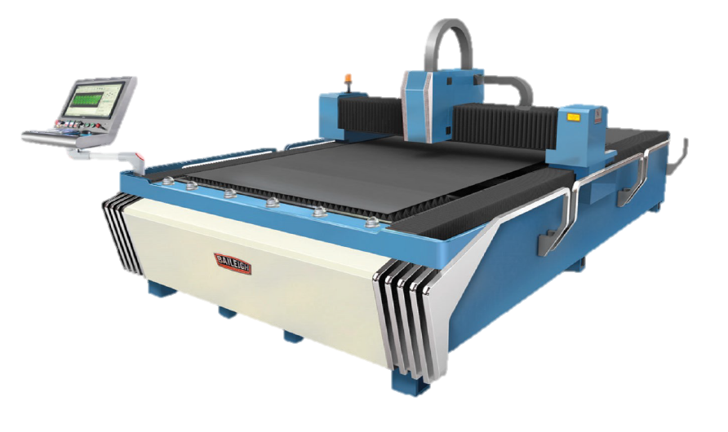
Haas VF-3SSYT
3 Axis CNC vertical milling machine
Power: 22.4kW
12 000 rpm inline direct drive
1016 x 660 x 718 mm max capacity
Tool changer capacity: 30+1
Additional 4th axis
Probe system for easier tool setup
Haas ST-35Y
CNC lathe with Y axis
Power: 29,8kW
3200 rpm spindle
457 x 584 mm max capacity
305 mm hydraulic chuck
24 station turret with 4000 rpm live tooling
Probe system for easier tool setup
Parts catcher
Conventional mill and lathe
Office :
Administrative
Sales
Development
Storage Area :
Materials stock
Consumables
Parts to assemble
Tooling
Critical spare parts
…
Staff room
Metrology lab :
Reference surfaces
Profile projector
Measurement column
Micrometres
Assembly area:
Manual sheet bender
Hydraulic press
Drill press
Belt grinder
Band saw
…
Welding area:
TIG welder
Chiller
Fume extractor
Welding table
Clamps/fixtures
Baileigh FL-510HD-1000
CNC laser table
1000 watt fiber laser
1500 x 3000 mm max capacity
Thickness cutting capacity:
Steel: 9.5mm
Aluminium: 2.5mm

